Slide 1
TV Error Codes
User Testing – Code given
10th February

Slide 2

What we wanted to test

Slide 3
Objectives
  See how easily testers understand the TV error screen, and what they would do next
  Understand what testers would do to solve their problem on the Error messages page
  Find out if the steps to diagnose their TV issues made sense to testers, and what they would expect this journey to look like
  Understand anything they would like to alter about this journey
Tasks
  Read the TV error screen
  Explain how they would proceed on the Error messages page
  Continue down the steps to diagnose their issues
Feedback TabThe Feedback Tab is a static icon that hugs the side of the browser window, overlaying your page content.

Slide 4
Methodology
  Remote unmoderated testing on UserZoom – think out loud studies
  Fieldwork – 8th February
  Mobile (6 users)
Sample
  Existing design on prototype
  Existing Virgin Media TV customers
  People who have previously had some TV issues
Feedback TabThe Feedback Tab is a static icon that hugs the side of the browser window, overlaying your page content.

Slide 5
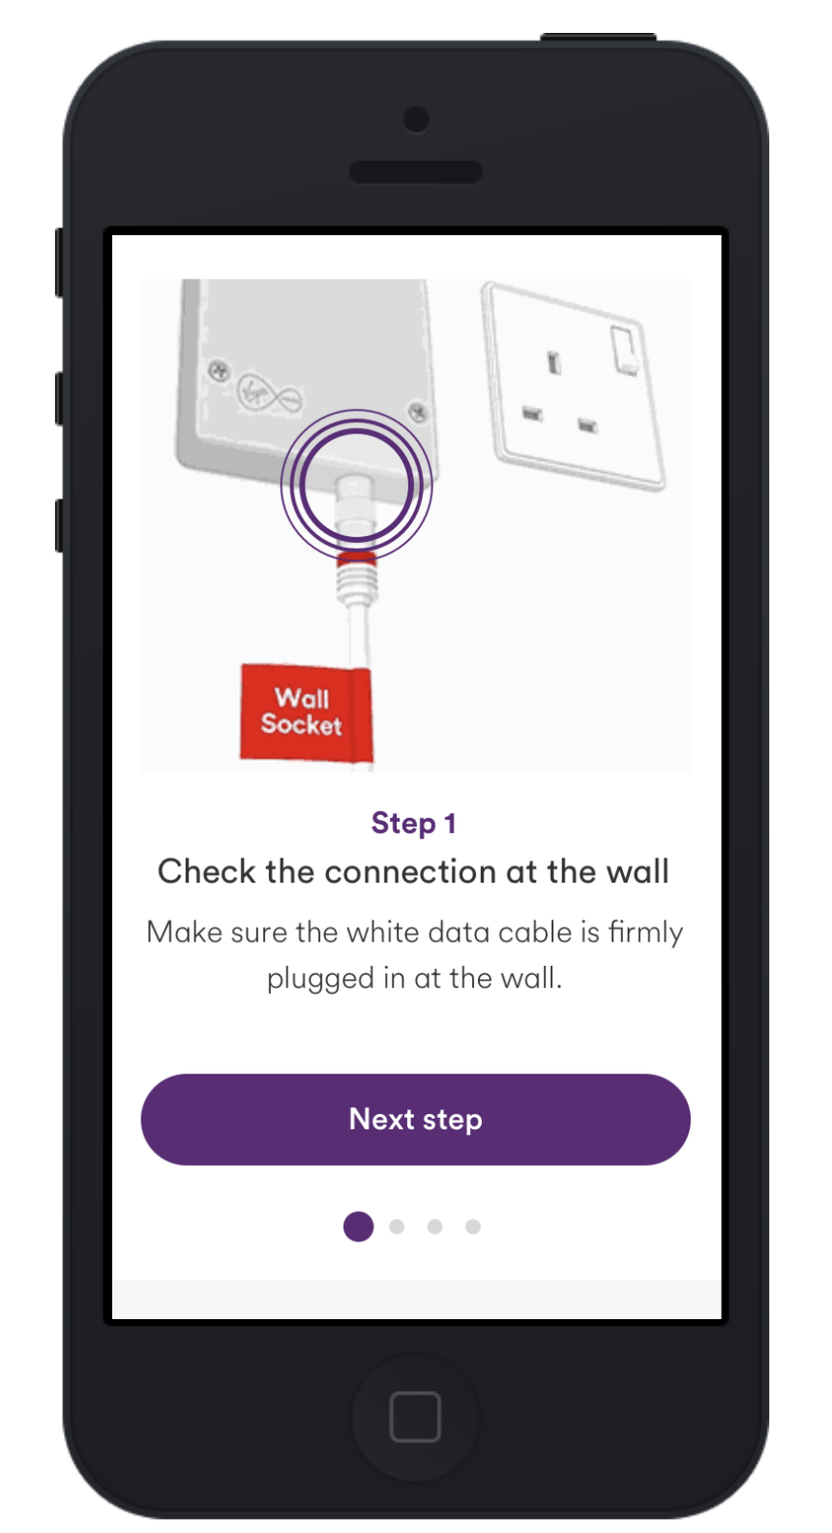
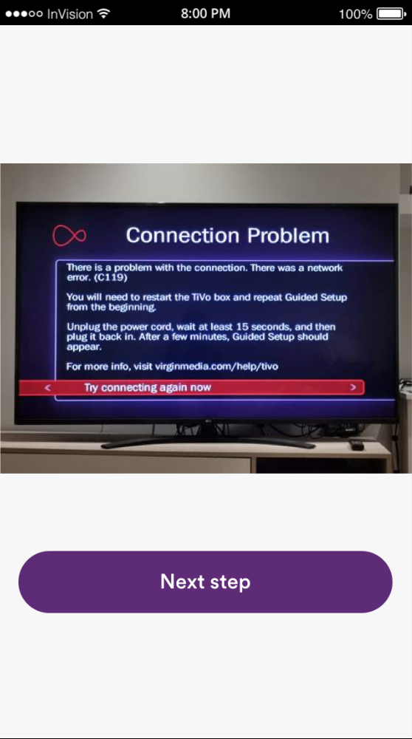
First part – TV Error Screen
Feedback TabThe Feedback Tab is a static icon that hugs the side of the browser window, overlaying your page content.

Slide 6
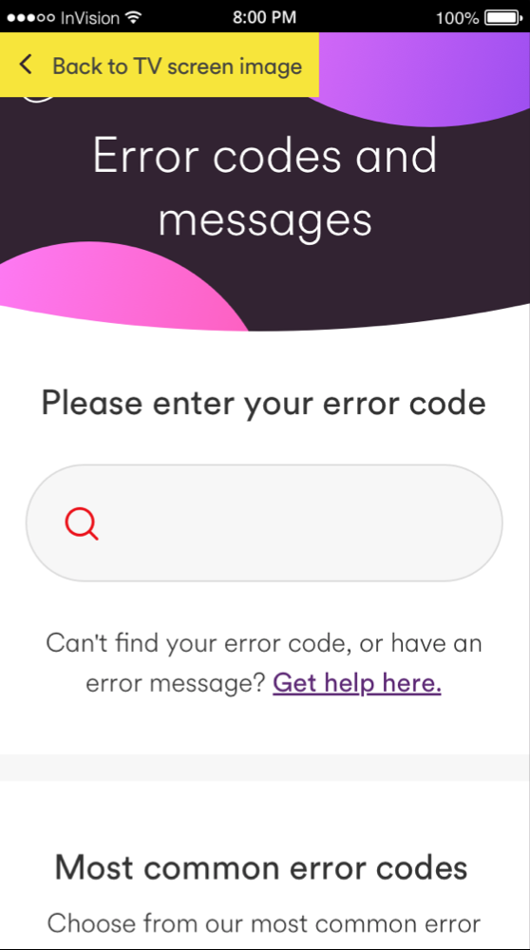
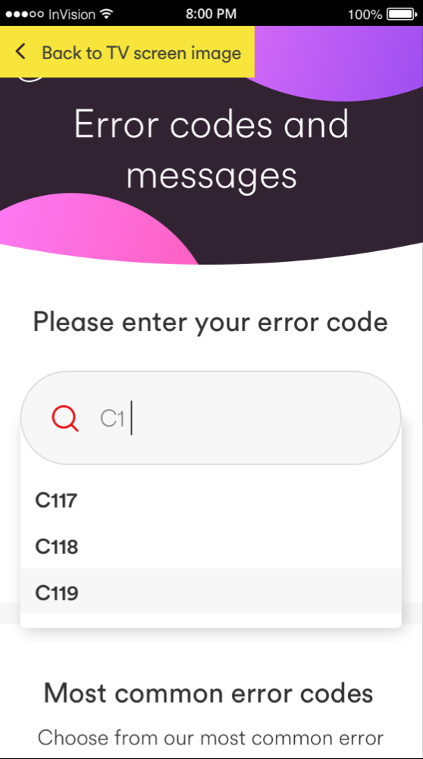
Second part – Error messages home
Feedback TabThe Feedback Tab is a static icon that hugs the side of the browser window, overlaying your page content.

Slide 7
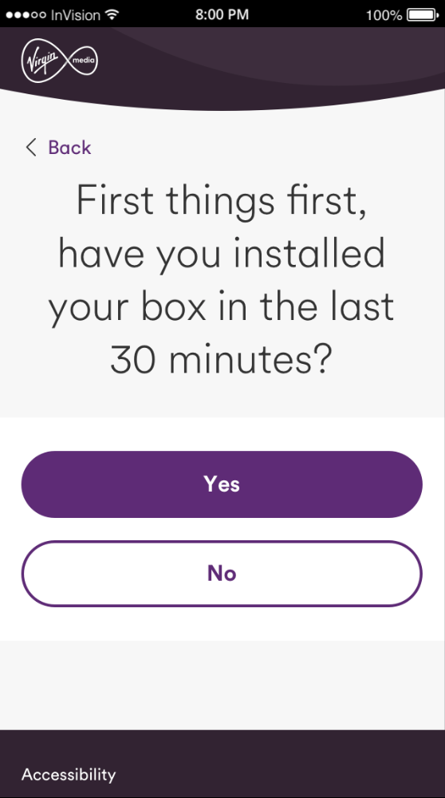
Third part – Installed last 30 minutes page
Feedback TabThe Feedback Tab is a static icon that hugs the side of the browser window, overlaying your page content.

Slide 8
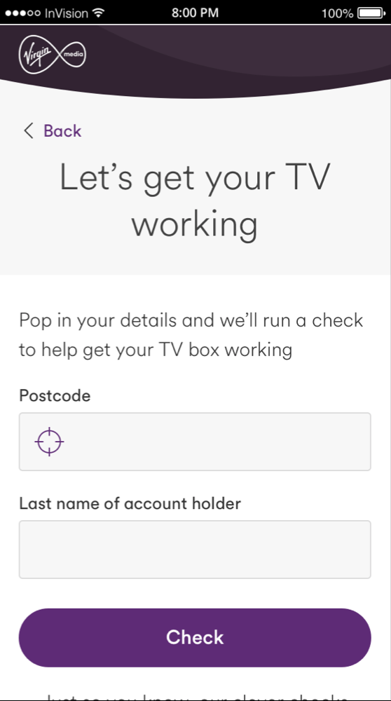
Fourth part – Personal details entry
Feedback TabThe Feedback Tab is a static icon that hugs the side of the browser window, overlaying your page content.

Slide 9
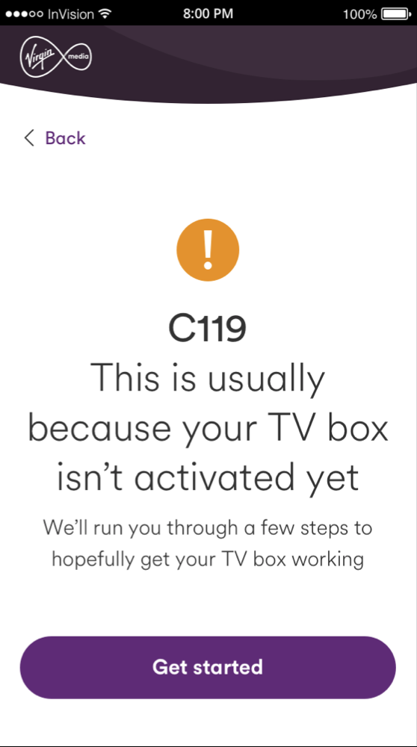
Fifth part – C119 Code
Feedback TabThe Feedback Tab is a static icon that hugs the side of the browser window, overlaying your page content.

Slide 10
Findings

Slide 11
First part – TV Error Screen
Positives
  Testers understand this page in depth, and would follow the instructions on screen
  Testers also know other techniques, such as turning everything on and off again and checking cables
  Most testers read that there is a website to go to, and one tester thinks correctly that they could go online and search for error codes
Negatives
  Some testers would try what is on screen, but after exhausting this and restarting/checking cables, would resort to calling rather than going online
  Not all testers spot the code. Some testers do see it, and some after going and looking again, but not all testers found it
Feedback TabThe Feedback Tab is a static icon that hugs the side of the browser window, overlaying your page content.

Slide 12
Second part – Identifier
Positives
  Most testers know very quickly to put an error code in the box to help diagnose their issue
  Some testers explore the rest of the page, noting they could click on most common errors if their error was there, and can search below using the alphabetic sorting function
Negatives
  One tester thinks that everything on this page is referring to a postcode, and is doing a postcode check
Feedback TabThe Feedback Tab is a static icon that hugs the side of the browser window, overlaying your page content.

Slide 13
Third part – Installed last 30 minutes page
Positives
  Most testers expect some kind of page like this, with a diagnostic flow to get them to a page where they would have the right issue and something to do about it
Negatives
  One tester is unsure what would be next, and assumes the flow would be the same advice that she saw on the TV screen at the beginning
Feedback TabThe Feedback Tab is a static icon that hugs the side of the browser window, overlaying your page content.

Slide 14
Fourth part – Personal details entry
Positives
  All testers are happy about putting their personal information in here to help solve their issues
Feedback TabThe Feedback Tab is a static icon that hugs the side of the browser window, overlaying your page content.

Slide 15
Fifth part – C119 Code
Positives
  All testers are quickly understand what the error message is telling them, and know to continue to solve their issues by clicking ‘Get started’
  All testers expect the step by step help to come
Negatives
  One tester says if this particular error came up in real life, they would be annoyed, as they would have already activated their box, but say they would still follow the steps
Feedback TabThe Feedback Tab is a static icon that hugs the side of the browser window, overlaying your page content.

Slide 16
Other general feedback
  Some testers thought there were too many steps, and would’ve preferred to skip steps they had tried in real life
  Some testers wanted more visual guides, maybe a video
  Some testers wanted to be able to talk to someone/a chatbot
Feedback TabThe Feedback Tab is a static icon that hugs the side of the browser window, overlaying your page content.

Slide 17
What’s next?

Slide 18
What’s next?
  Ensure the TV screen points users to the right place for help online
  Make it even clearer the TV error page isn’t asking for postcodes
  Think about how steps can be condensed, and if steps can be organised so that some can be skipped
Feedback TabThe Feedback Tab is a static icon that hugs the side of the browser window, overlaying your page content.

Slide 19
Thanks

